Slide 1
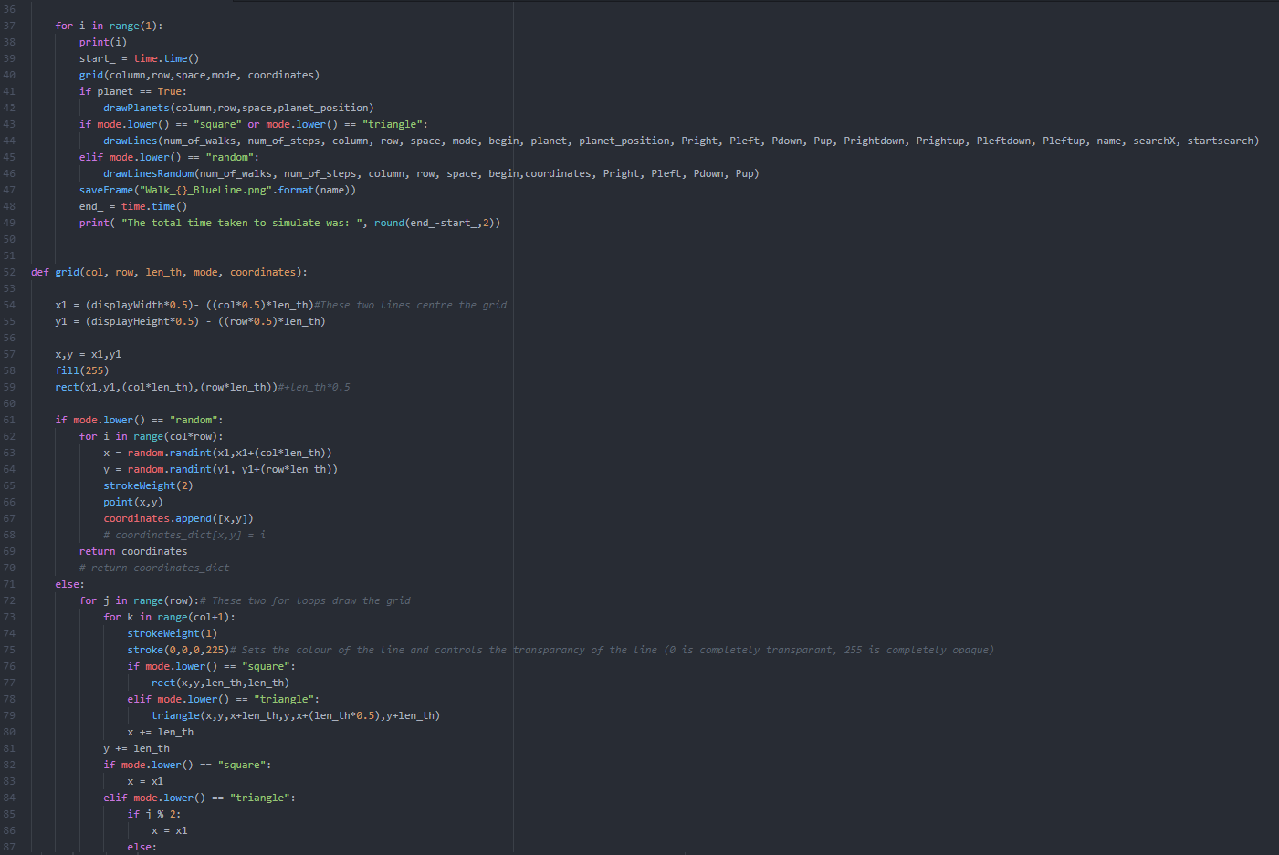
Developing Computational Methods of Modelling Quantum Gravity
By:
Ina Kastrati, Gaspar Gomez, Ayub Salah,
Krishan Sritharar, and Ben Cookson

Slide 2
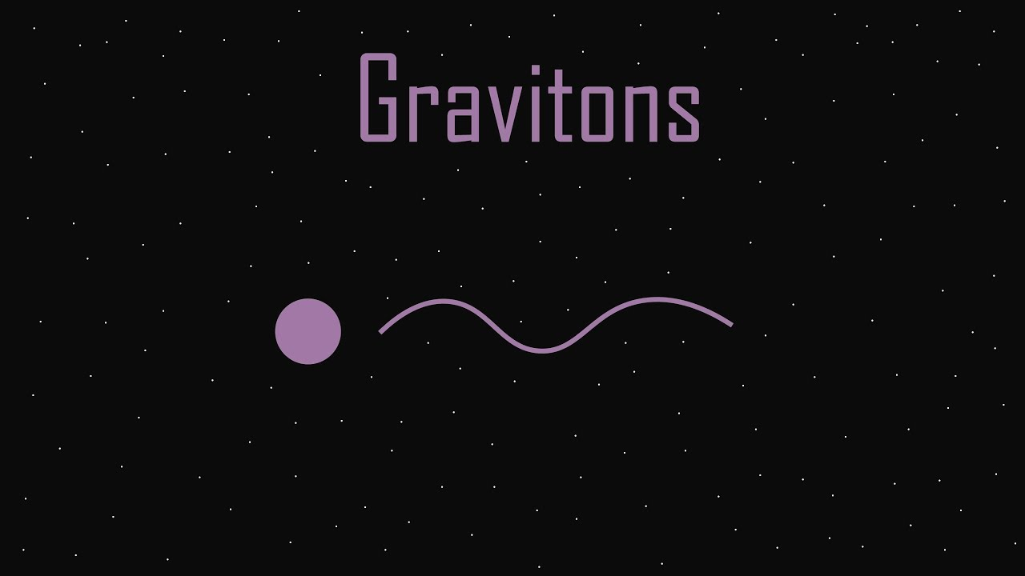
Theory of Quantum Gravity
In order to agree with the known theories of gravity, a “Graviton” must have certain properties:
Massless
Quantum spin of 2
Electrically neutral

Slide 3
The Problem:
A Graviton has never been seen, as gravity is so weak, it’s impossible to produce a graviton on earth.
100,000,000,000,000, 000,000,000,000,000, 000,000,000,000
times weaker than the Strong Interaction
Gravity is

Slide 4
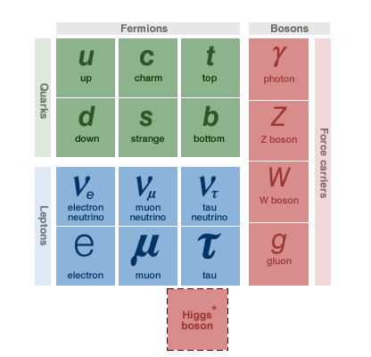
Forces:
Current understanding of gravity based on theory of Relativity (a classical system).
Other fundamental forces of Physics employ quantum theories.
Standard Model includes all known particle interactions/forces except gravity

Slide 5
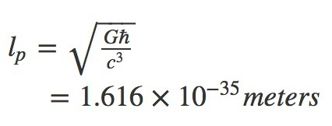
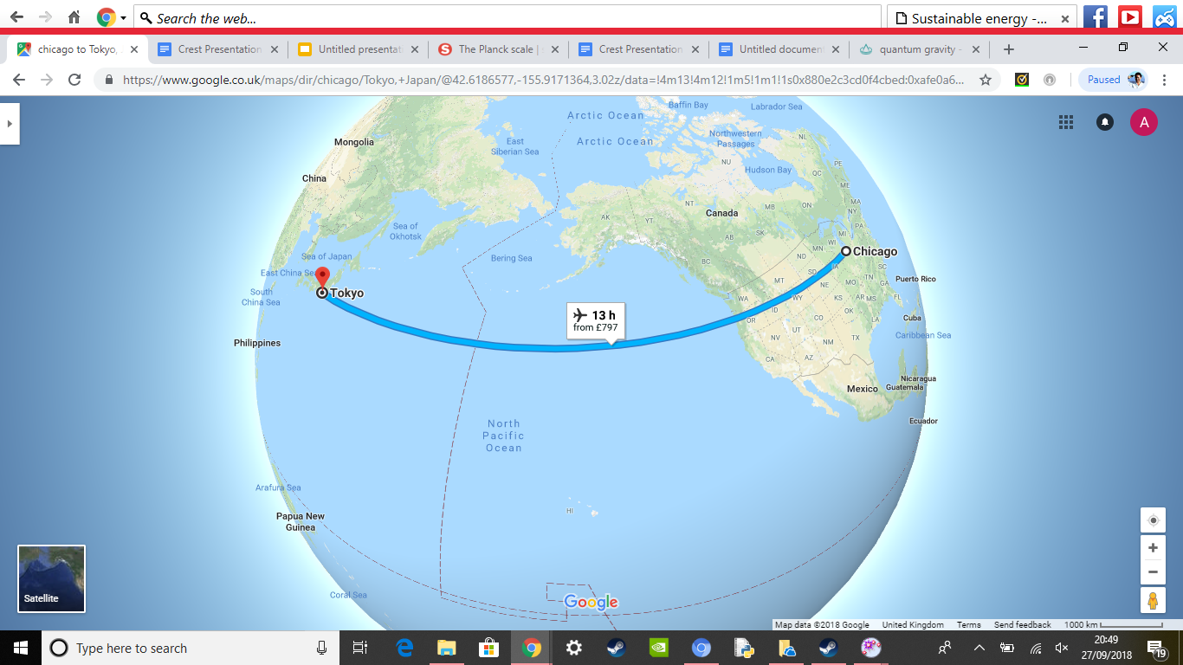
If we scaled a proton up to the size of the observable universe, the Planck length would be a trip from Tokyo to Chicago
Planck length = 1.6 ×10⁻³⁵ metres

Slide 6

Random Walk
Notes:
We wanted to model how light from a distant star would move in space. So we set up various random walks - which is a path made up of a series of steps that are determined through probability, it would mirror a sort of path a drunk person would take. Our first random walk was made up of equal probability, as can be seen on the slide, the light had an equal chance of going left, right, up or down.

Slide 7

Random Walk
This drunk person has an equal probability of going in any direction
25%
25%
25%
25%

Slide 8
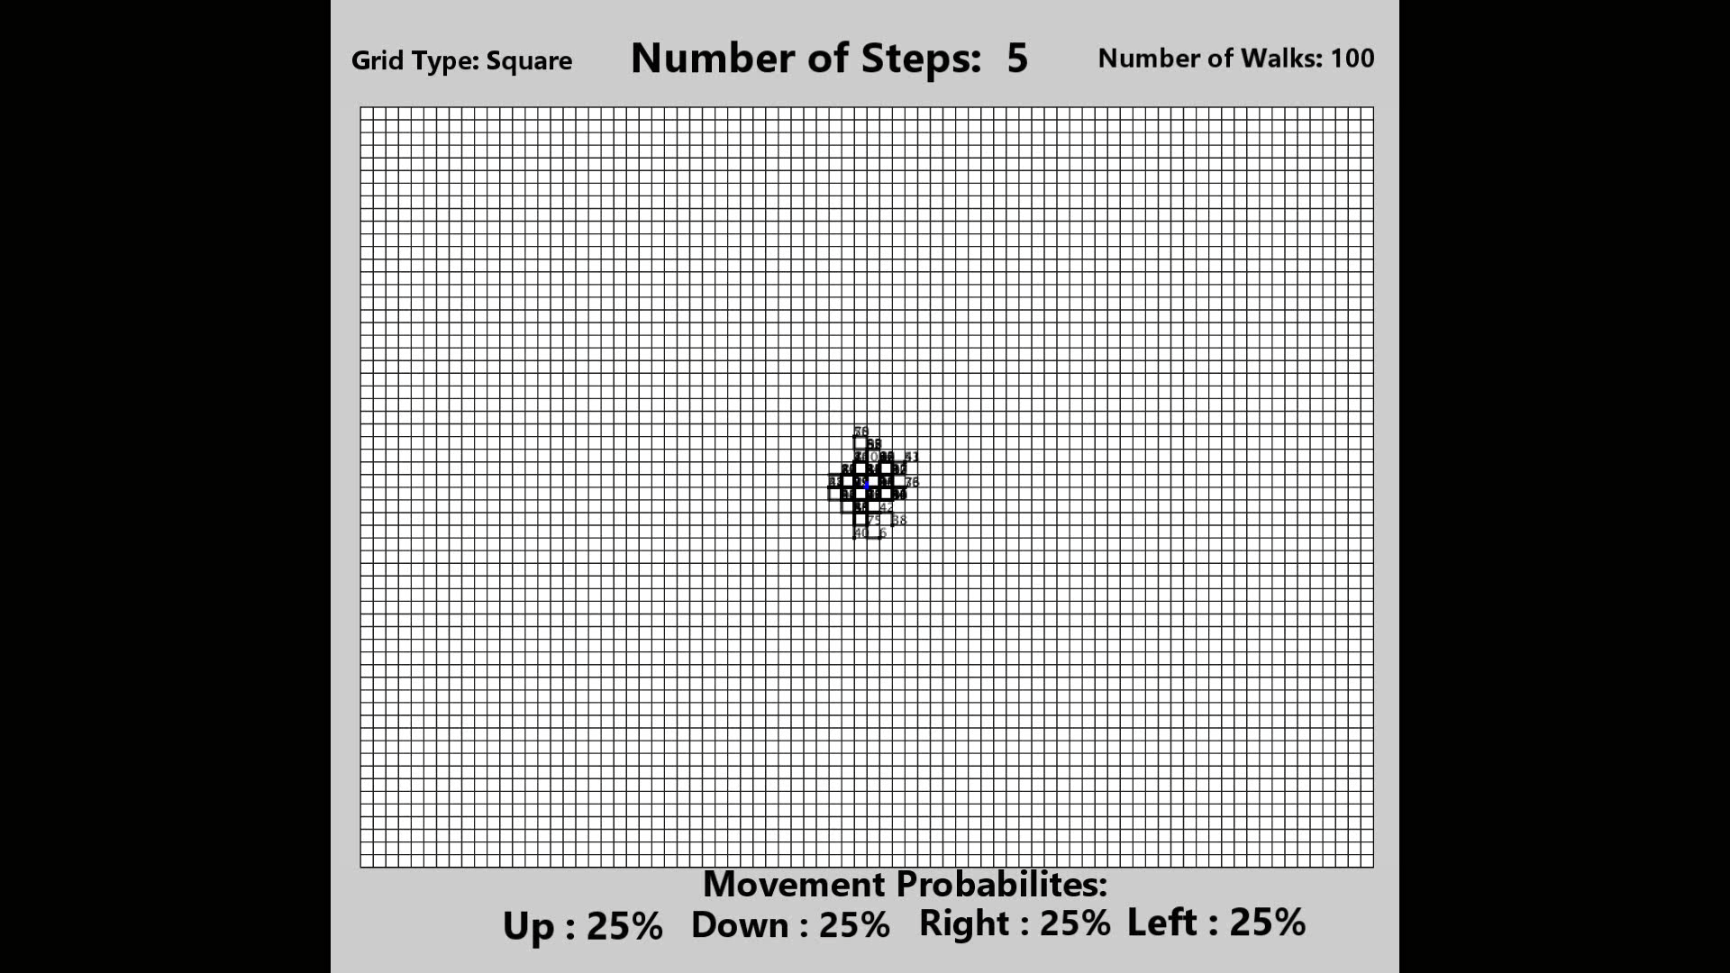
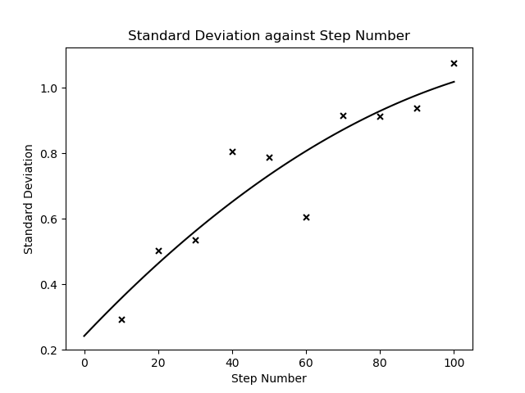

Theory vs Results
$σ(of Mean Distance)$ $∝ Step Number$

Slide 9
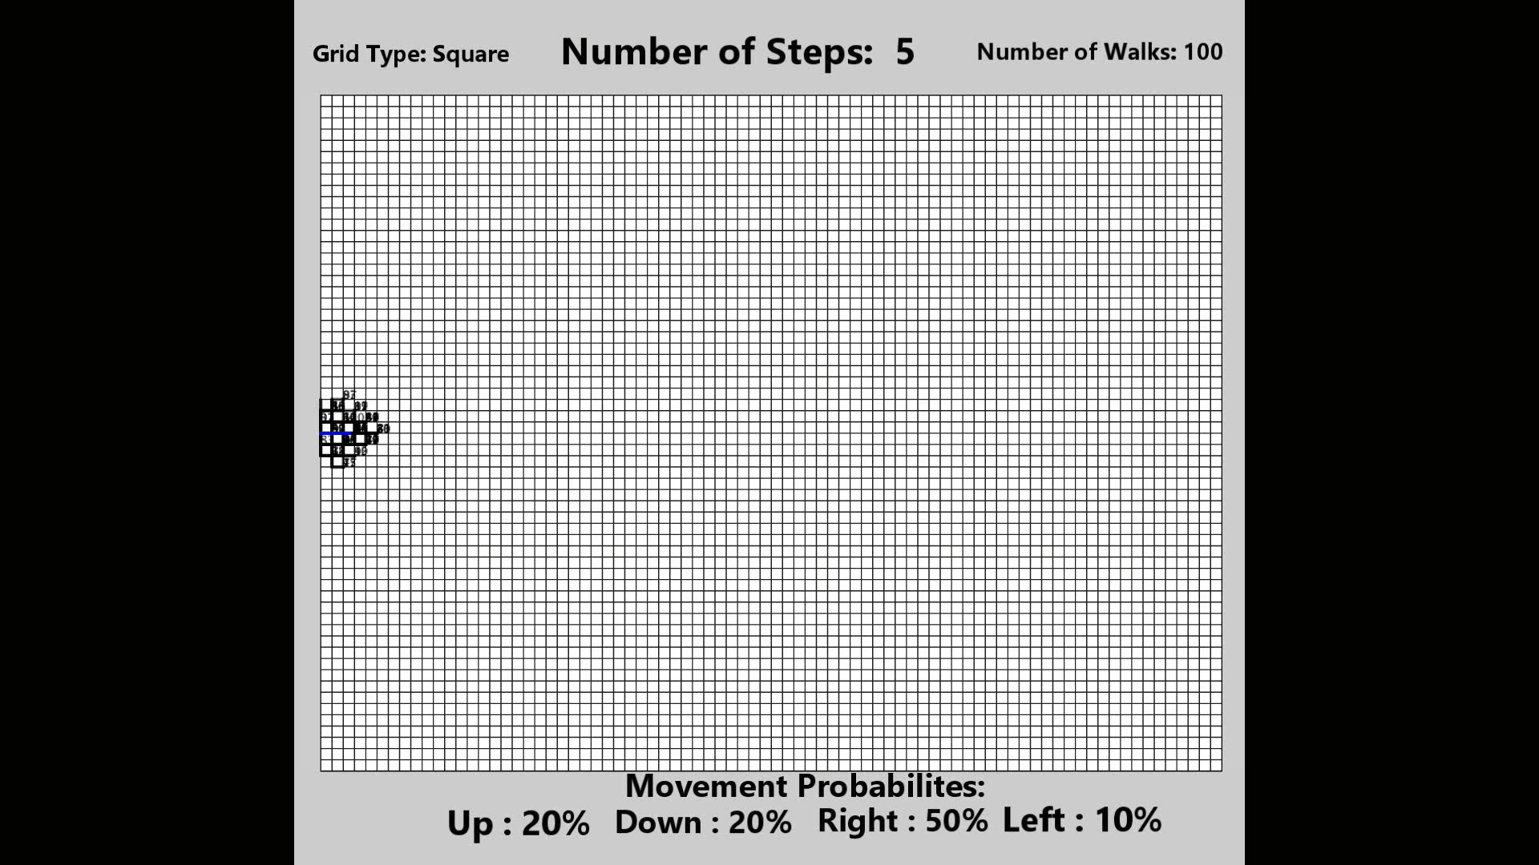
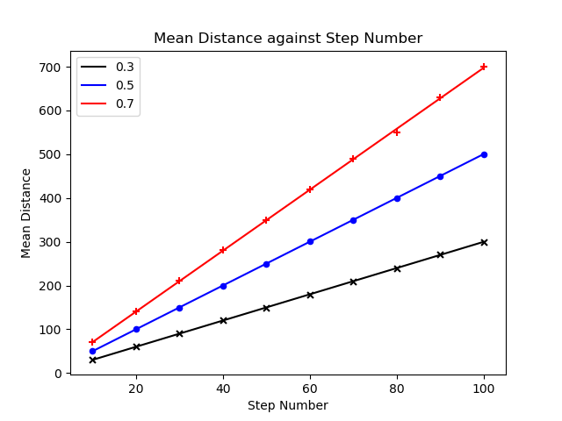
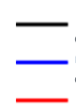
Theory vs Results
30%
Right =
50%
70%

Slide 10
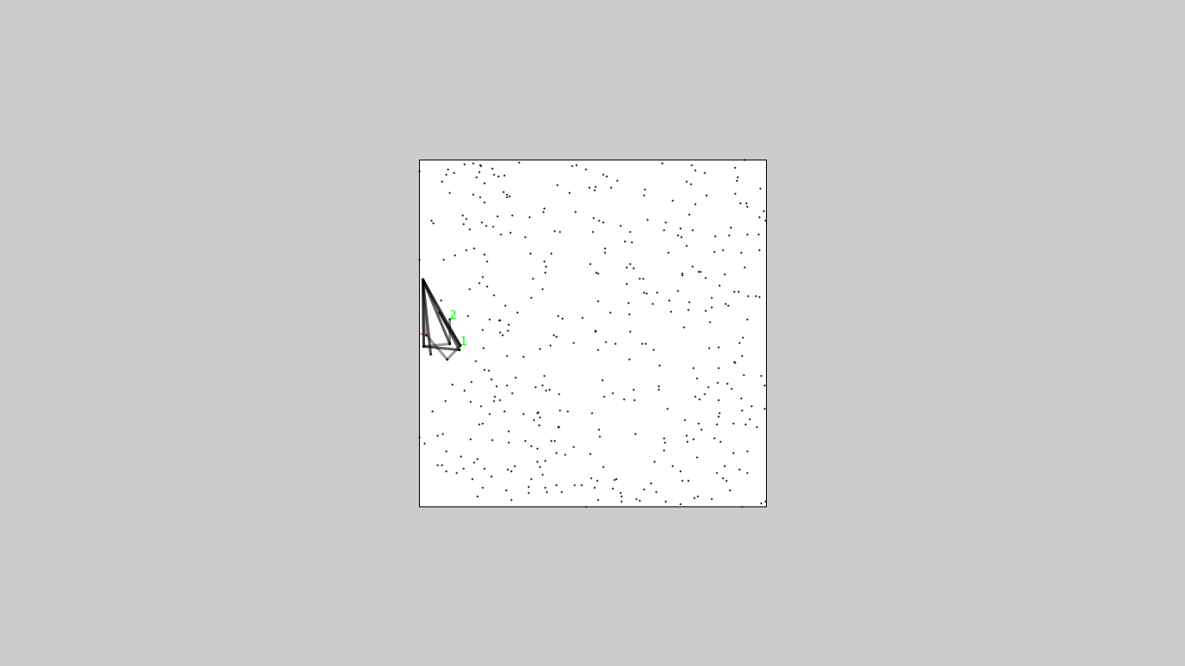
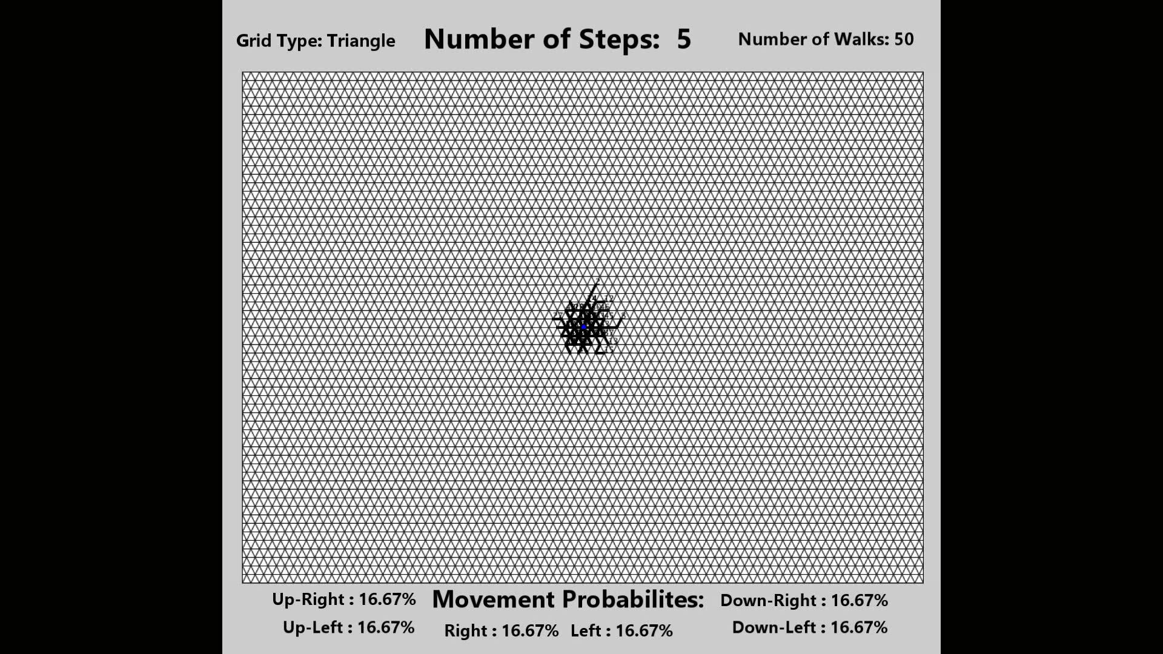
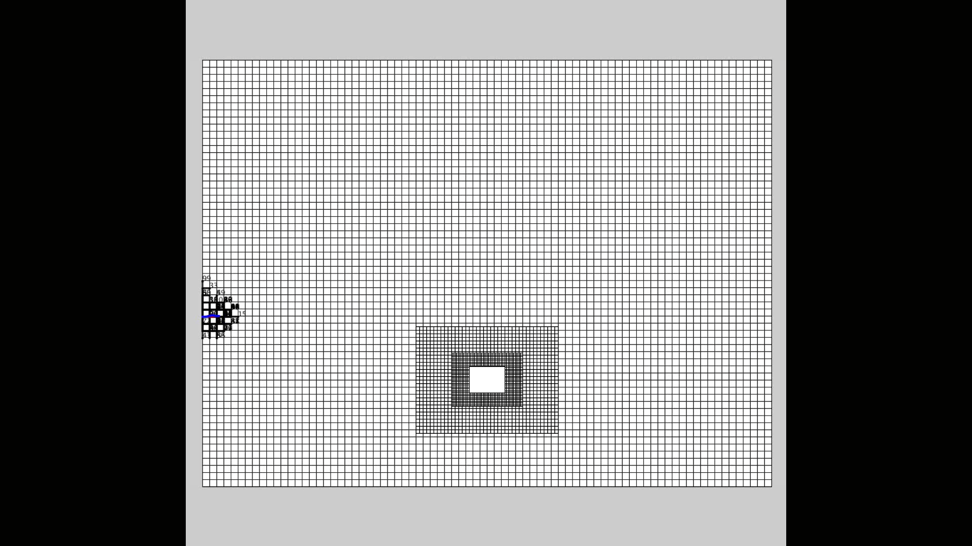
Generalisations
Random Grid
Random Walk with mass
Isometric Grid

